Slide 1
GERMANY
DEVELOPMENT OF DICTATORSHIP

Slide 2
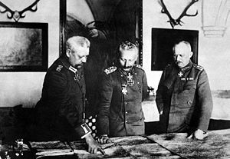
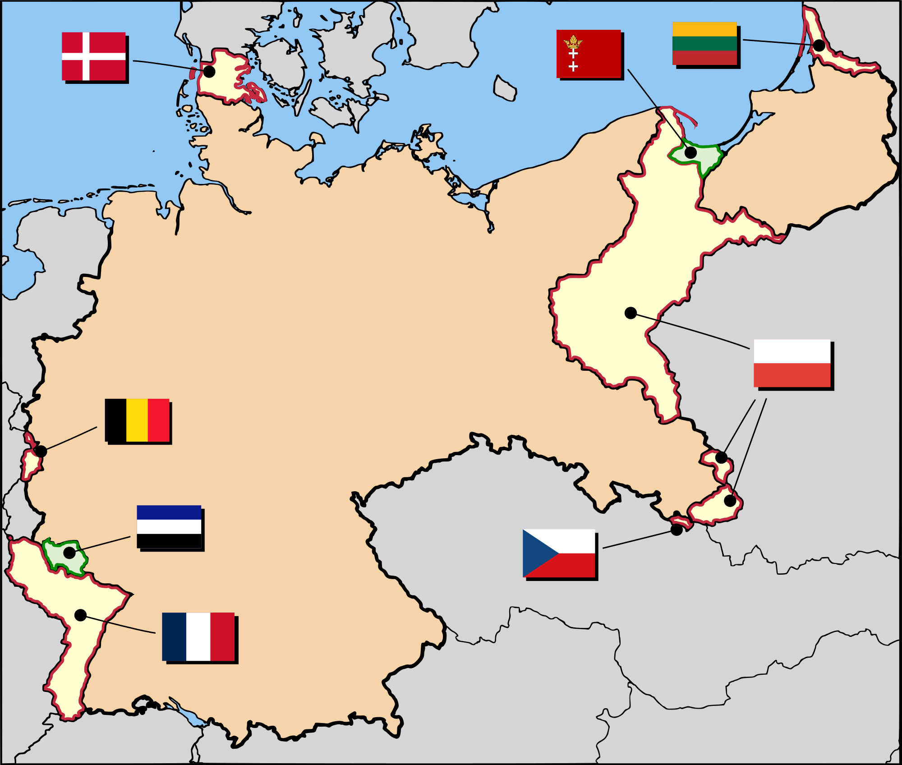
Establishment of the Weimar Republic
Kaiser Abdication
Weimer Republic
Treaty of Versailles
Bye Bye
forEach(4 => Parliament)
forEach(7 => President)
Reparations
Demilitarization
Fault
Voting Rights (1920) | UK | France | Germany
Men | 30+ | 21+ | 20+
Women | 30+ | Null | 20+

Slide 3
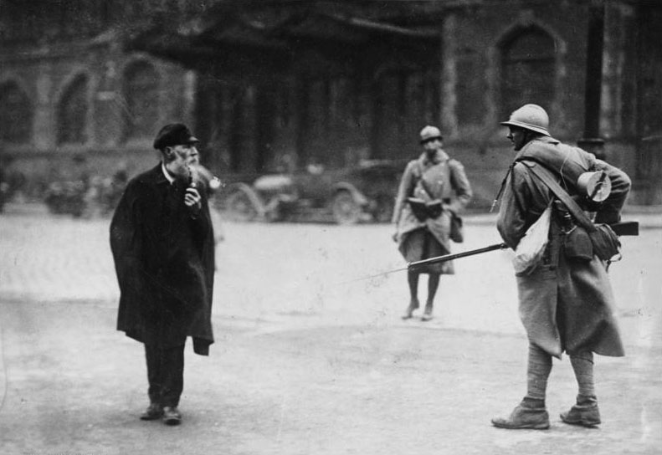
Crisis
Occupation of Ruhr
Hyperinflation
Printing more money
E.g.
Jan. 1923
Bread 🍞 – 163 Marks
Nov. 1923
Bread 🍞 – 75 000 000 000 Marks

Slide 4
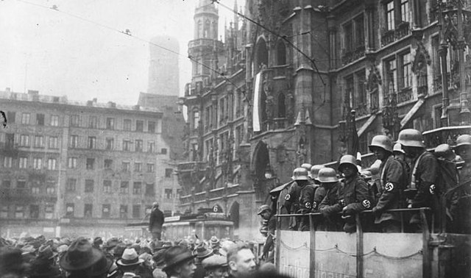
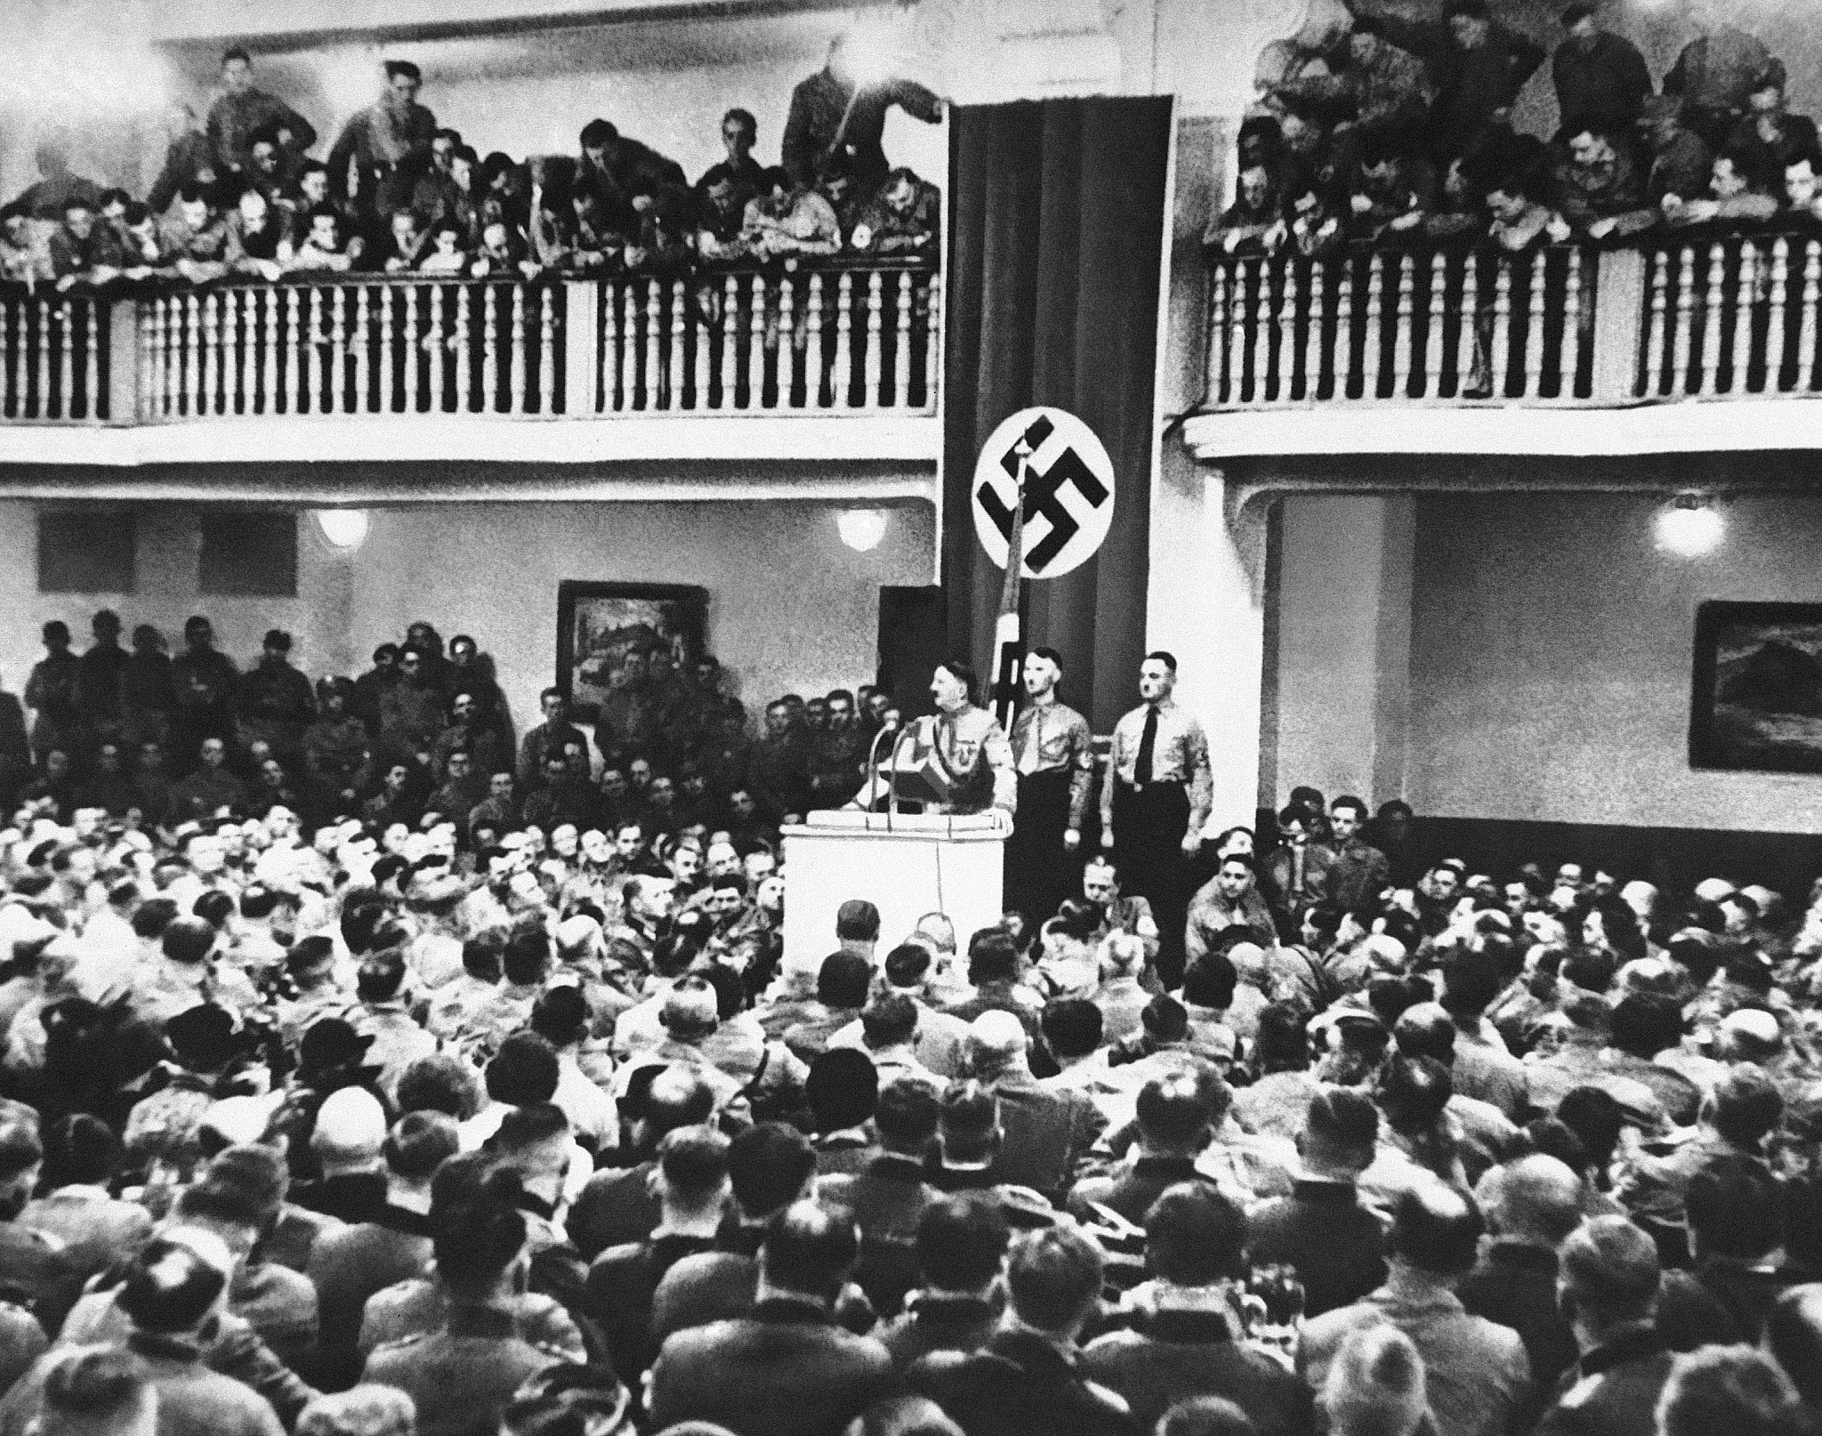
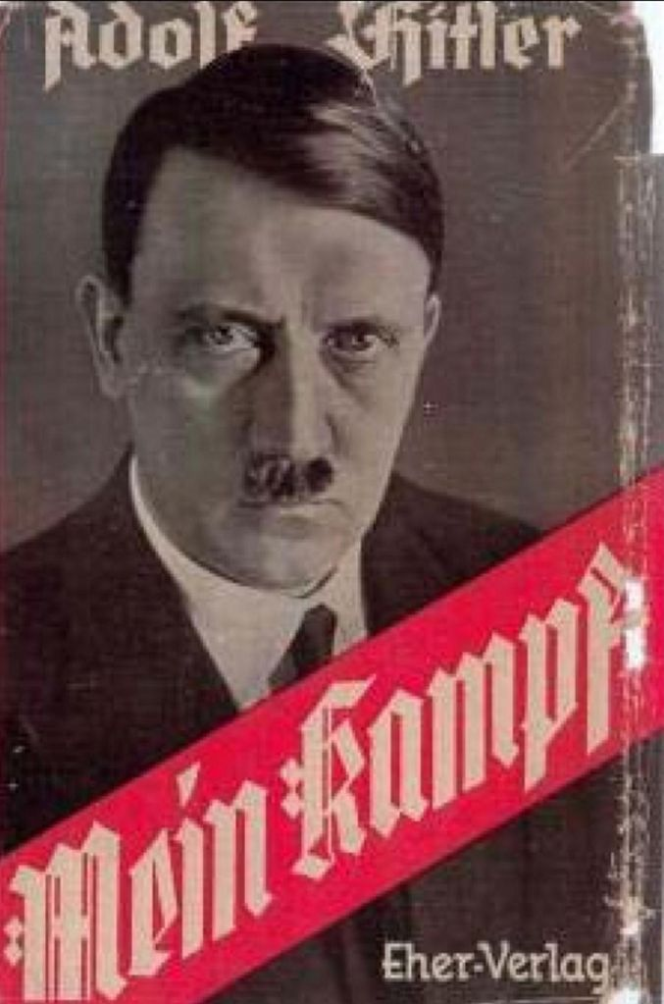
Munich Putsch

Slide 5
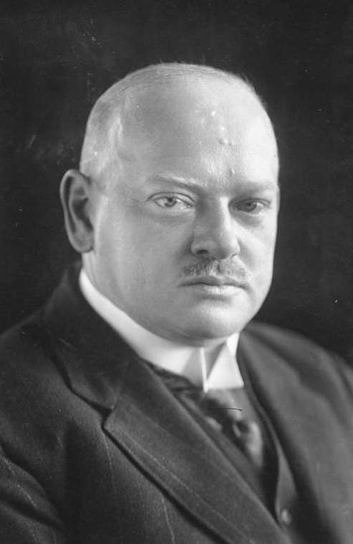
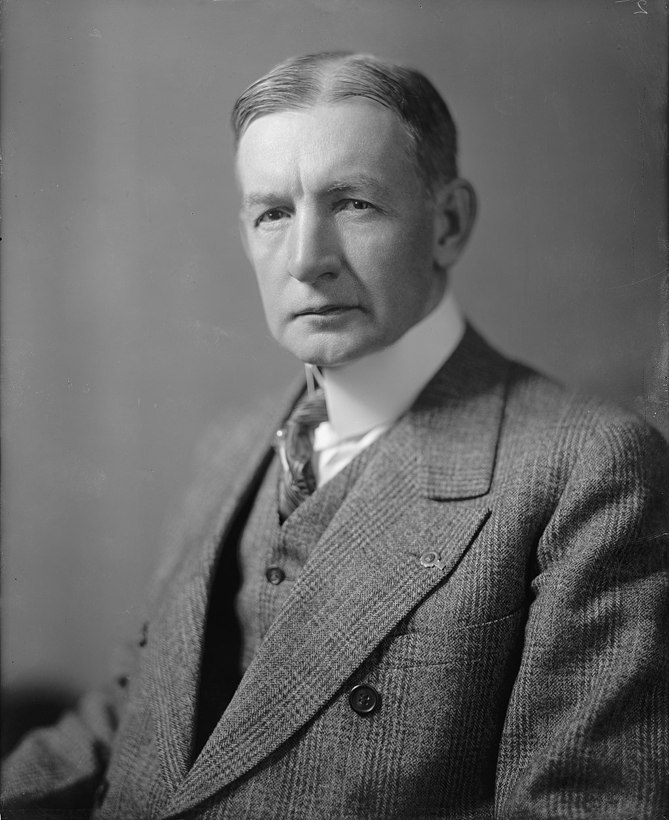
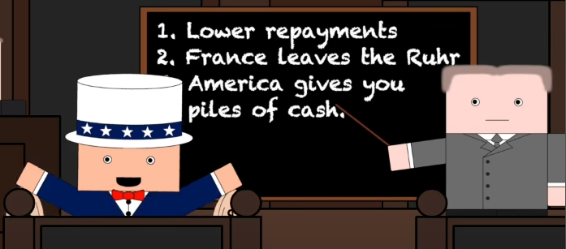
Recovery
Gustav Strassman
USA
Repaired Relations
Allies
Germany
Charles Dawes
THE GREAT DEPPRASSION
Support From US

Slide 6

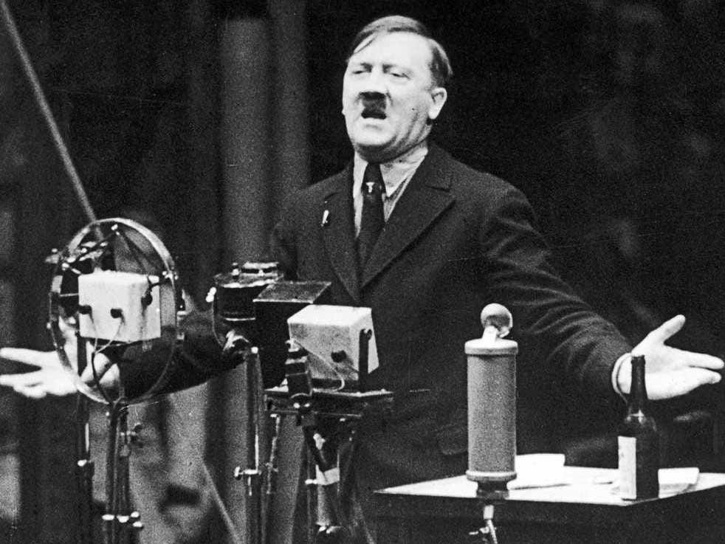
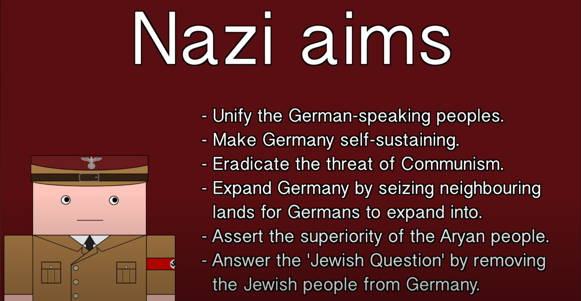
Rise in Nazi Party
Going Legal
Nazi Ideology
Outcome?
After Munich Putsch
Treaty Of Versailles
Limit Foreign Involvement

Slide 7
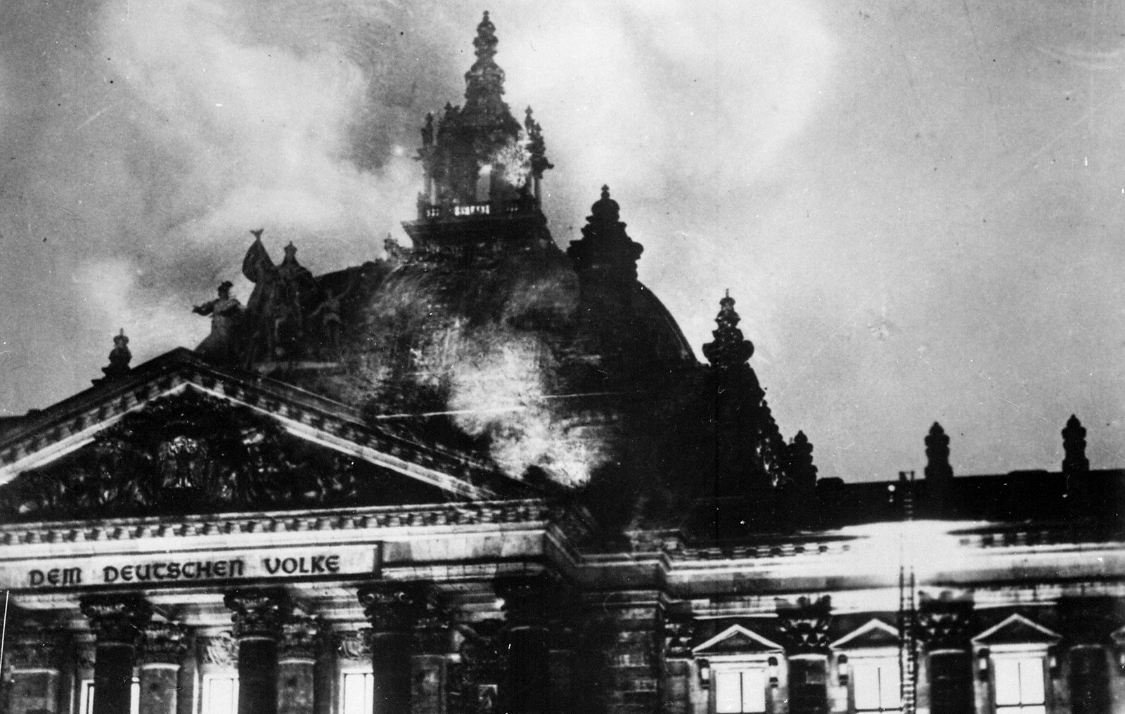
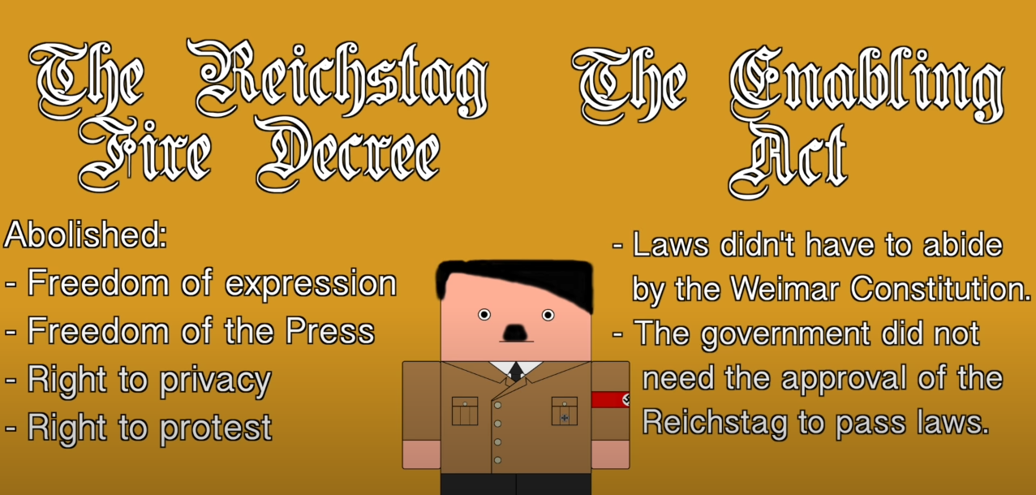
Unlimited POWER
Hindenburg refusing to make Hitler Chancellor
Hindenburg making Hitler Chancellor
“Commies” Starting a FIRE 🔥
Enabling Act

Slide 8



Moments
No Trade Unions
The Night of the Long Knives
No Freedom
Communism Status
Sabotaging….
Yourself?
But higher standars of living

Slide 9
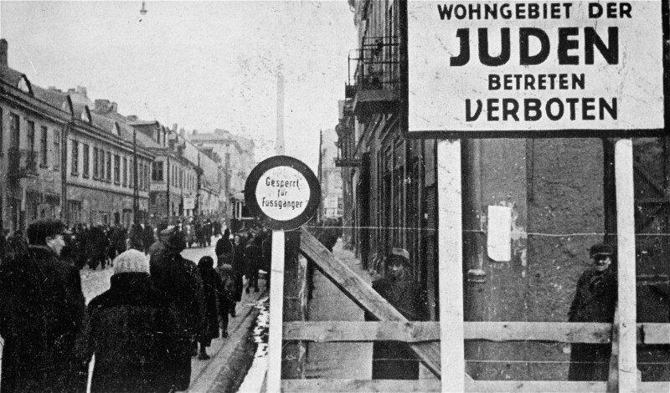
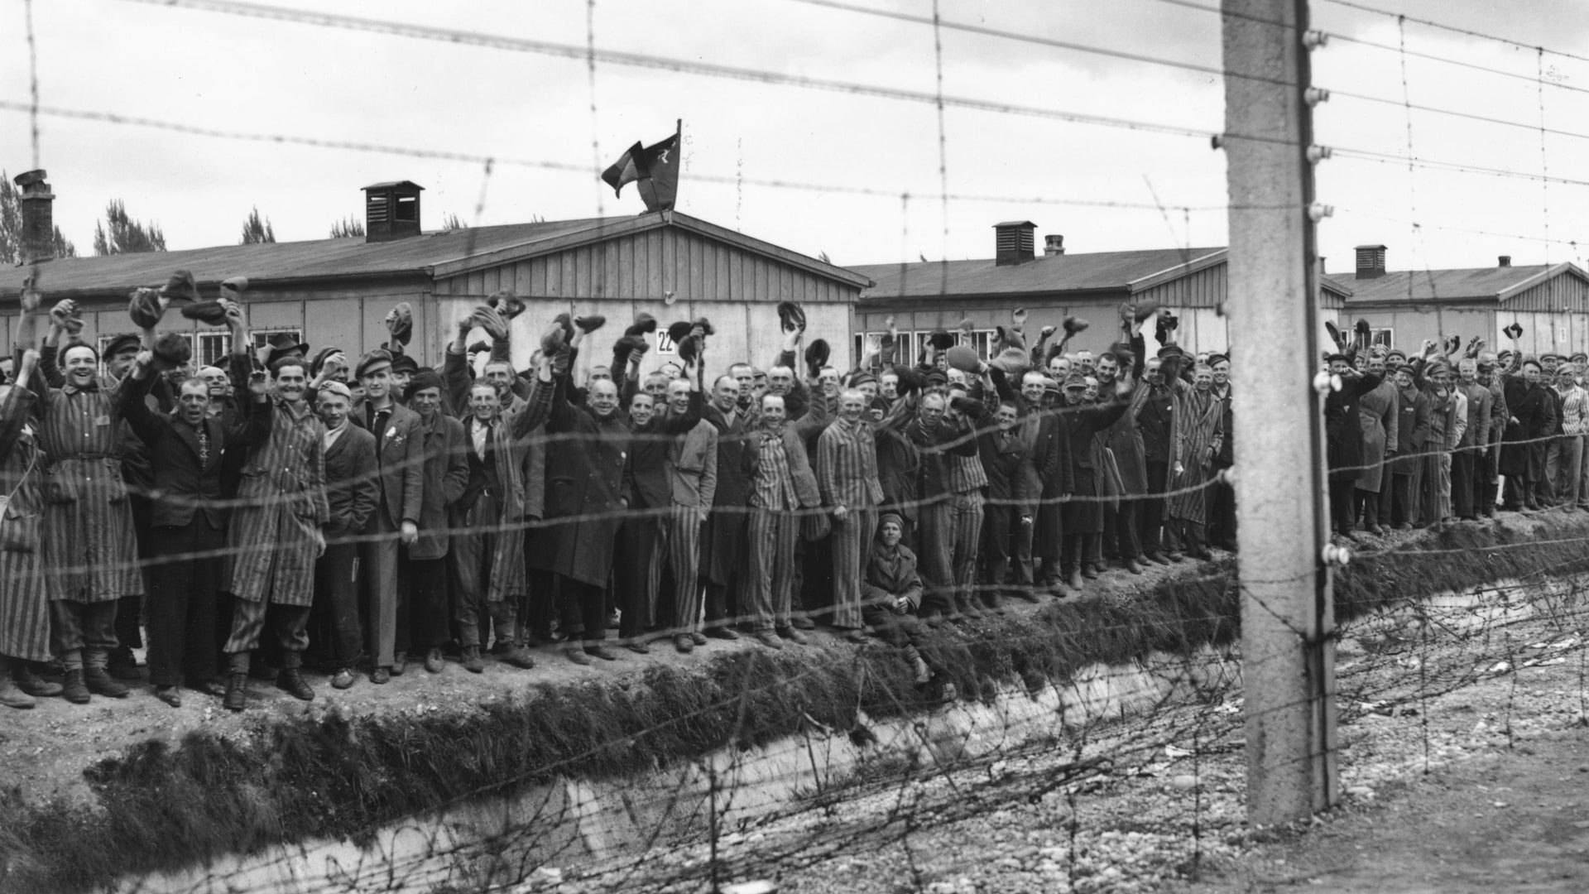
Policies towards Jews
Ghettoisation
Isolation
Concentration Camps
Force Labor
Extermination
Death

Slide 10
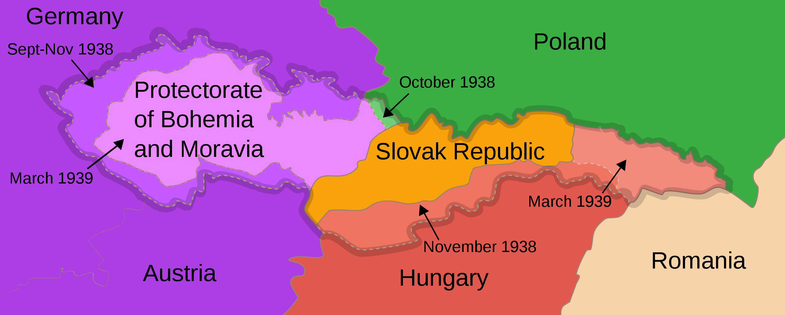




Timeline
1938 March
1939 Seqtember
Anschluss
Invasion of Poland
Armament
1938 Octomber
1939~1945
Rest of Europe
Dismantlement of Czechoslovakia
Start of WWII

Slide 11
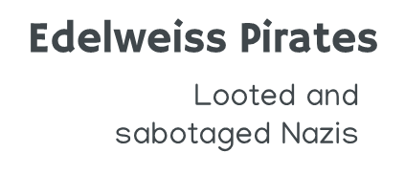



Resistance

Slide 12
Thanks
Do you have any questions?
Please keep this slide for the attribution

